Slide 1
CptS 440 / 540 Artificial Intelligence
Review and Philosophical Questions

Slide 2
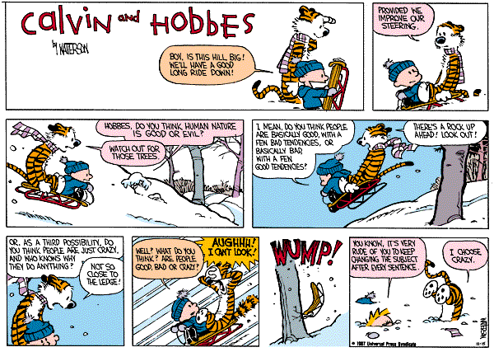
Review and Philosophical Questions

Slide 3
How Many AI Researchers Does It Take to Change a Lightbulb?
[Rich and Knight, 1991]

Slide 4
How Many AI Researchers Does It Take to Change a Lightbulb?
The Search Group
One to define the goal state
One to define the operators
One to decide on the least-cost, nearest-optimality search algorithm
One to decide on a heuristic that indicates how close we are to a changed lightbulb
One to indicate about how it is a model of human lightbulb-changing behavior
One to call the Lisp hackers

Slide 5
How Many AI Researchers Does It Take to Change a Lightbulb?
The Lisp Hackers
One to bring up the network
One to order the Chinese food
Four to hack on the Lisp debugger, compiler, window system, and microcode
One to write the lightbulb-changing program

Slide 6
How Many AI Researchers Does It Take to Change a Lightbulb?
The Logic Group
One to figure out how to describe lightbulb changing in predicate logic
One to show the adequacy of predicate logic One to show the inadequacy of predicate logic
One to show that lightbulb logic is nonmonotonic
One to show that it isn't nonmonotonic
One to incorporate nonmonotonicity into predicate logic
One to determine the bindings for the variables
One to show the completeness of the solution
One to show the consistency of the solution
One to hack a theorem prover for lightbulb resolution
One to indicate how it is a description of human lightbulb changing behavior
One to call the electrician

Slide 7
How Many AI Researchers Does It Take to Change a Lightbulb?
The Fuzzy Logic Group
One to point out that, in the real world, a lightbulb is never "on" or "off", but usually somewhere in between

Slide 8
How Many AI Researchers Does It Take to Change a Lightbulb?
The Robotics Group
One to build a vision system to recognize the dead bulb
One to build a vision system to locate a new bulb
One to figure out how to grasp the lighbulb without breaking it
One to figure out the arm solutions that will get the arm to the socket
One to organize the construction teams
One to hack the planning system
One to indicate how the robot mimics human motor behavior in lightbulb changing

Slide 9
How Many AI Researchers Does It Take to Change a Lightbulb?
The Game-Playing Group
One to design a two-player game tree with the robot as one player and the lightbulb as the other
One to write a minimax search algorithm that assumes optimal play on the part of the lightbulb
One to build special-purpose hardware to enable 24-ply search
One to enter the robot in a human lightbulb-changing tournament
One to state categorically that lightbulb changing is “no longer considered AI”

Slide 10
How Many AI Researchers Does It Take to Change a Lightbulb?
The Learning Group
One to collect thirty lightbulbs
One to collect thirty “near misses”
One to write a concept-learning program that learns to identify lightbulbs
One to show that the program found a local maximum in the space of lightbulb descriptions

Slide 11
How Many AI Researchers Does It Take to Change a Lightbulb?
The Neural Network Group
One to claim that lightbulb changing can only be achieved through massive parallelism
One to build a backpropagation network to direct the robot arm
One to assign initial random weights to the connections in the network
One to train the network by showing it how to change a lightbulb (training shall consist of 500,000 repeated epochs)
One to tell the media that the network learns “just like a human”
One to compare the performance of the resulting system with that of symbolic learning approaches (optional)

Slide 12
Philosophical Questions Regarding AI
We have been concentrating on techniques to get AI to work
Philosophers have been attacking the big questions
How CAN minds work?
How DO human minds work?
Can nonhumans have minds?

Slide 13
Weak AI Position
Machines can be made to act as if they were intelligent
There are things that computers cannot do, no matter how we program them
Certain ways of designing intelligent programs are bound to fail in the long run
The task of constructing the appropriate programs is infeasible

Slide 14
Strong AI Position
Machines that act intelligently can have real, conscious minds
Weak AI doubts can be refuted
Locate a task thought impossible, design a program to accomplish task
Helps identify and remove AI researcher assumptions
Strong AI doubts are difficult to refute
Hard to define
Hard to prove or disprove

Slide 15
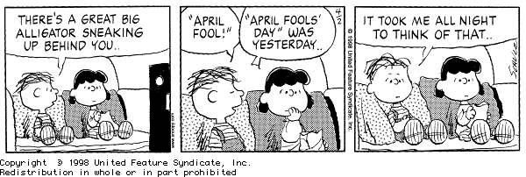
Possibility of Achieving Intelligent Behavior
Can machines "think"? What does "think" mean?
Can a machine reason about intentionality and consciousness? A machine needs to be aware of its own mental state and actions
An intelligent agent needs emotions
Kismet, the sociable robot
An intelligent agent needs humor
AI needs to understand satire
An intelligent agent must be creative
Aaron, Computer Artist
Musical Intelligence

Slide 16
Brain Prosthesis Experiment
Gradually replace human neurons with electronic devices
Electronic counterparts have identical I/O behavior
Will consciousness of subject change? If so, when?

Slide 17
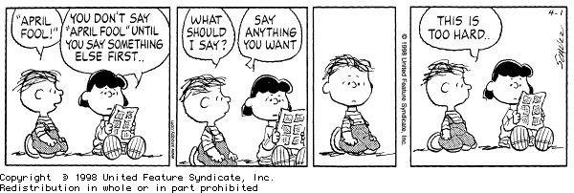
AI: Present and Future
Have we succeeded yet?
Many tasks present, a few fundamental limitations

Slide 18
Other AI Research
There are other areas of study in AI that are also needed and are being pursued
Natural language processing
Researchers predicted this would be the first task achieved
Turns out to be one of the most difficult
Language learning
Speech recognition
Example using speech and lip reading
Additional machine learning techniques
Reinforcement learning, Bayes classification, Nearest neighbor, Inductive logic programming, graph-based learning
Multiagent systems
Robotics
The "action" component of an intelligent agent
Robot planetary explorer
Robot fire-fighting competition
Honda humanoid robot
Cog MIT robot
Example of multi-robot systems
Another example of multi-robot systems
Robot flocking
Robot sheepdog
Additional examples

Slide 19
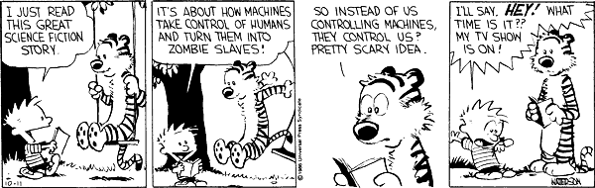
What If We Succeed?
Legal responsibility
Should intelligent agents have rights?
Job security
Affirm uniqueness of humanity
Privacy issues
``The success of AI might mean the end of the human race.''
How some perceive the future of AI
Panel discussions
HAL
Another example
What do you think?
How should we use this technology?

Slide 20
AI Grand Challenges
Translating telephone
Accident avoiding car
Read college text and answer questions at the end
Pass standardized tests (SAT)
Identify all genes and therapeutic targets for specific types of cancer
Fraud detection based on company financial statements before it is caught
Discover new law publishable in journal for the related discipline
Sponsored grand challenges:
DARPA Grand Challenge
RoboCup
Netflix Prize
Loebner prize

